Slide 1
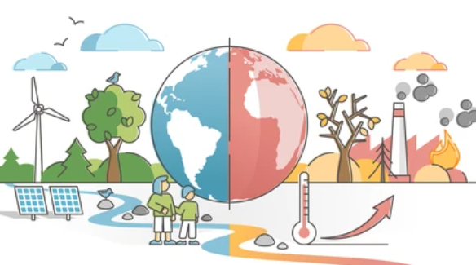
Bridging Emissions and Investments: A Visual Analysis of Greenhouse Gas Trends and Green Bond Financing
DATS 6401 Team 2:
Abhilasha Singh
Mohammed Ismail Sarfaraz Shaik
Pranjal Wakpaijan
Rahul Arvind
Yonathan Shimelis

Slide 2
Introduction and Background
Climate change is one of the most complex global challenges, driven by greenhouse gas emissions.
Despite awareness, GHG emissions have increased by 51% from 1990 to 2021.
Climate Clock counts down the time remaining to limit global warming to 1.5°C above pre-industrial levels

Slide 3


Slide 4
Data Story
Despite growing green bond investments, emissions continue to rise.
Are these funds making a real impact, or are they greenwashing?
Our visualizations reveal trends and possible gaps between climate finance and environmental outcomes.

Slide 5
Objective and Goals
Identify the major contributor to greenhouse gas emissions.
Identify top greenhouse gas-emitting industries.
Track emission trends by continent and sector (2010–2022)
Analyze the annual surface temperature trends across the world.
Understand green bond financings over years.

Slide 6
Dataset Descriptions
Dataset 1: IMF Annual Greenhouse Gas Emissions Account(2010-2022)
Dataset 2: IMF Green Bonds Issuance (1985–2022)
Dataset 3: IMF Annual Surface Temperature Change (1961–2023)
Contains both Numerical and Categorical variables
Source: International Monetary Fund (IMF) - Climate Data Portal (Annual Greenhouse Gas Emissions Account).
Limitations: Some of the counties and continents are missing in our dataset.

Slide 7
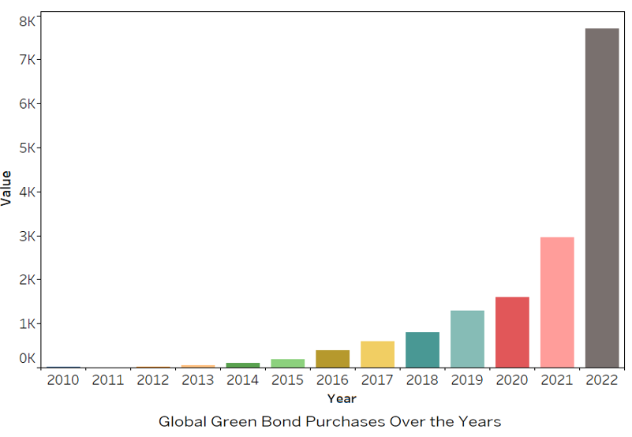
Global investment in green bonds has grown consistently over time

Slide 8
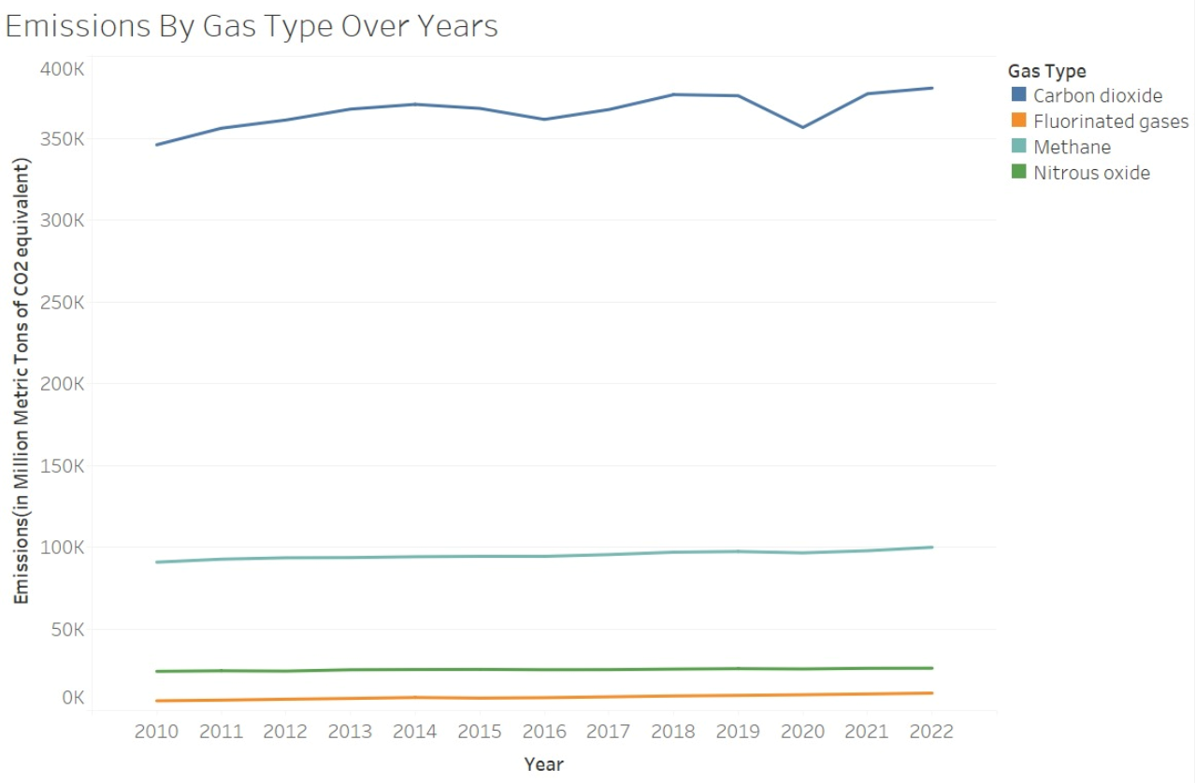
Carbon dioxide is the leading contributor to greenhouse gas emissions.

Slide 9
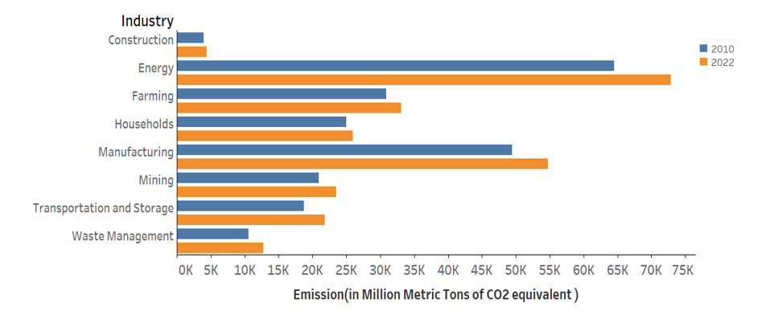
Energy and manufacturing industries are the largest contributors to emissions during both years

Slide 10
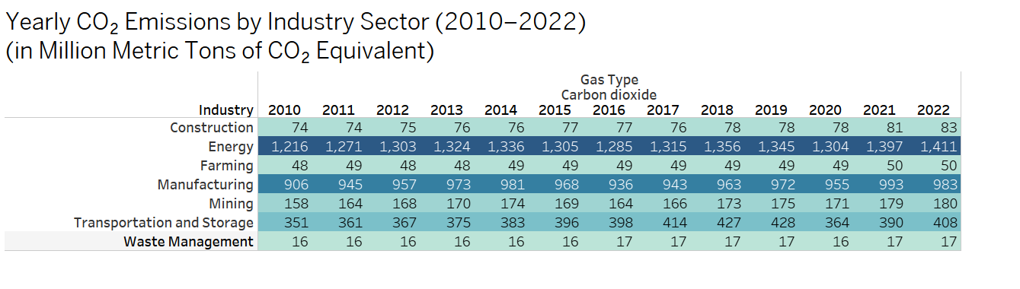
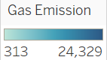
This deeper look reveals consistent upward trends in carbon dioxide emissions in nearly every sector over the 12-year period. The energy and manufacturing sectors once again emerge as the dominant contributors to emissions.

Slide 11
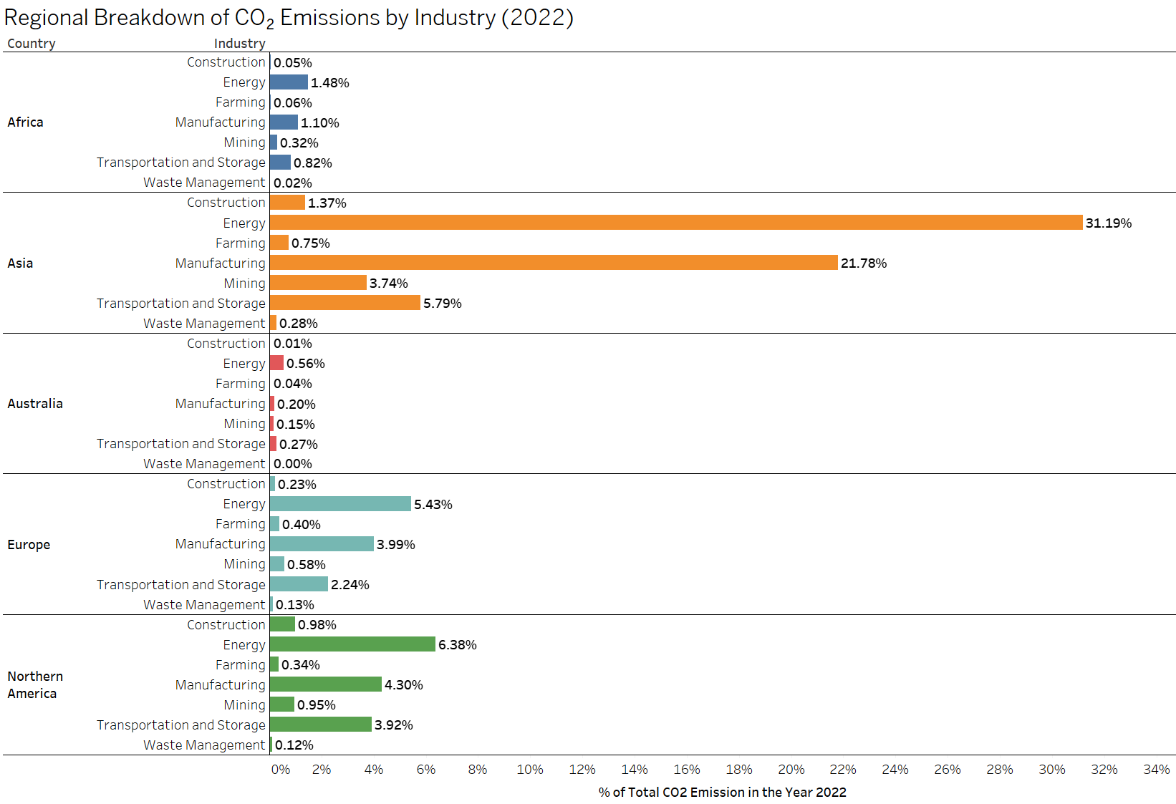
Asia stands out with a notably higher percentage of emissions from the energy and manufacturing sectors compared to other regions

Slide 12
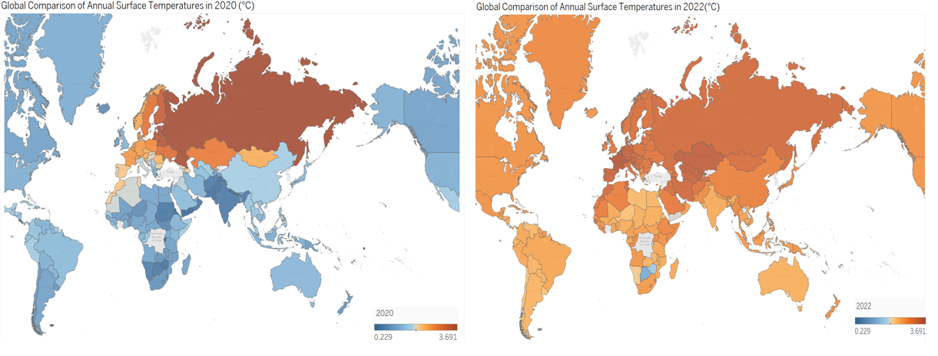
From 2020 to 2022, notable differences in temperature shifts can be observed. In 2020, most countries experienced a decrease in surface temperature, which may be attributed to the global impact of COVID-19 lockdowns that significantly reduced human activity. In contrast, 2022 shows a general increase in surface temperatures across the map.

Slide 13
Key Insights
Persistent Rise in Emissions: Emissions keep rising despite growth in green bond investments.
Sector Dominance: Energy and manufacturing are the top global emitters, led by Asia.
Climate Financing Concerns: Green bonds show limited impact, raising concerns of greenwashing.
Impact of Global Events: 2020 temperature drops highlight human activity’s effect on climate.

Slide 14
Conclusion
Our analysis underscores a critical gap between financial efforts aimed at sustainability and actual environmental outcomes. To achieve meaningful change, policy-makers and investors must reassess current strategies, ensuring green financing is genuinely aligned with impactful and measurable emission reduction initiatives.

Slide 15

Any thoughts or questions?

